Slide 1
Notes:
This is the Vertical Listing presentation made exclusively for offices enrolled in the Michael Lewis Marketing Suite.
Software Required:
For editing: Powerpoint or Keynote
This version of the Listing Presentation was created for printing purposes and makes a great leave behind when used in tandem with the iPad Listing Presentation.
Items Required to Customize this Presentation:
Headshot of Agent
Professional Bio / Profile of Agent
Letter to Agent’s Client
Link to Website
Link to Facebook
QR Code linking to your virtual tour (optional)
Client’s Name (optional)
This Listing presentation is extremely customizable. All pages may be edited, duplicated, and/or deleted to suite your personal needs.

Slide 2
PREPARED FOR THE EXCLUSIVE USE OF:
CLIENT’S NAME
12345 ANYSTREET DRIVE, ANYCITY, ANYSTATE 000000
The information provided herein has been gathered from sources which are proprietary to Keller Williams Realty. As such, we understand this report to be for the private and confidential use of Keller Williams Realty, its’ representatives, and you, the property owner. Accordingly, this report should not be copied, reproduced or distributed in any way to third parties without our prior mutual agreement.
Notes:
This is where the client’s name goes.
Simply delete the placeholder information and replace it with the client’s information.
If you do not have a specific client at the moment then replace Michael’s information with this message:
“the clientele of {AGENT NAME}”
Change {AGENT NAME} with the agent.

Slide 3
PREPARED BY:
CHRISTOPHER SMITH
REALTOR
CaBRE # 012345
000.123.4567
Agent@KWagent.com
www.KWagent.com
12345 ANYWHERE STREET CITY STATE 00000
Notes:
Right click the Agent Photo and select “Change Picture.”
Navigate to your headshot and open it. Your headshot should automatically crop.
Change the contact information at the bottom of this document with your office and business contact information.

Slide 4
CLIENT’S NAME
12345 ANYSTREET DRIVE, ANYCITY, ANYSTATE 000000
This is where you type your personal message to your client. This is where you type your personal message to your client. This is where you type your personal message to your client. This is where you type your personal message to your client. This is where you type your personal message to your client. This is where you type your personal message to your client. This is where you type your personal message to your client. This is where you type your personal message to your client.
This is where you type your personal message to your client. This is where you type your personal message to your client. This is where you type your personal message to your client. This is where you type your personal message to your client. This is where you type your personal message to your client. This is where you type your personal message to your client. This is where you type your personal message to your client. This is where you type your personal message to your client.
CHRISTOPHER SMITH
REALTOR
CaBRE # 012345
000.123.4567
Agent@KWagent.com
www.KWagent.com
12345 ANYWHERE STREET CITY STATE 00000
Notes:
Replace this text with your prepared letter to your client.
Keep a general letter here but switch out the client name when applicable.
Change the contact information at the bottom of this document with your office and business contact information.

Slide 5
CHRISTOPHER SMITH
This is where you type your personal profile and all your accomplishments. This is where you type your personal profile and all your accomplishments. This is where you type your personal profile and all your accomplishments. This is where you type your personal profile and all your accomplishments. This is where you type your personal profile and all your accomplishments.
This is where you type your personal profile and all your accomplishments. This is where you type your personal profile and all your accomplishments. This is where you type your personal profile and all your accomplishments. This is where you type your personal profile and all your accomplishments. This is where you type your personal profile and all your accomplishments.
This is where you type your personal profile and all your accomplishments. This is where you type your personal profile and all your accomplishments. This is where you type your personal profile and all your accomplishments. This is where you type your personal profile and all your accomplishments. This is where you type your personal profile and all your accomplishments.
This is where you type your personal profile and all your accomplishments. This is where you type your personal profile and all your accomplishments. This is where you type your personal profile and all your accomplishments. This is where you type your personal profile and all your accomplishments. This is where you type your personal profile and all your accomplishments.
REALTOR
CaBRE # 012345
000.123.4567
Agent@KWagent.com
www.KWagent.com
12345 ANYWHERE STREET CITY STATE 00000
Notes:
Replace this photo with the agent headshot and replace CHRISTOPHER SMITH with the agent’s name.
Replace the Professional Profile template text with your prepared professional bio/profile.
Change the contact information at the bottom of this document with your office and business contact information.

Slide 6
Notes:
This is the marketing section. This is where the agent can talk about their marketing services as well as get a feel for how the client would like to market their property.

Slide 7
We want your home to be shown in the best possible light to prospective buyers to get you top dollar in the shortest amount of time.
We will create a warm and inviting environment focusing on the best architectural features and selling points of your home.

Slide 9
Keller Williams agents strategically advertise in several publications. Our display advertising appears in local, regional and national / international publications, which target specific audiences for unique or estate properties. Your sales agent will select the publications appropriate for the marketing of your property.
Notes:
This print media section can be customized to reflect the print media your office uses. If your office does not use print media feel free to delete these slides.

Slide 12
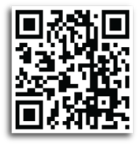
QUICK RESPONSE CODES
Put on All Marketing Materials
Designed to Direct User to another Destination.
DIGITAL VIDEO MARKETING
Your Property Virtual Tour will be loaded on
YouTube for Online Marketing Exposure
Notes:
Replace the default QR Code with a QR Code generated for the agent’s listing when available. If they do not yet have a virtual tour then the agent may use the default QR Code. It’s functional and when scanned links to a template virtual tour we have created.

Slide 13
EXTENDED MARKET REACH
When you list with me, we’ll have access to the Keller Williams Listing System, or KWLS. This proprietary, exclusive system ensures your property is marketed online 24/7 through more than 350 of the most popular search Websites.

Slide 14
www.yourwebsite.com
INSERT INFORMATION ABOUT YOUR WEBSITE OR IMAGE HERE

Slide 15
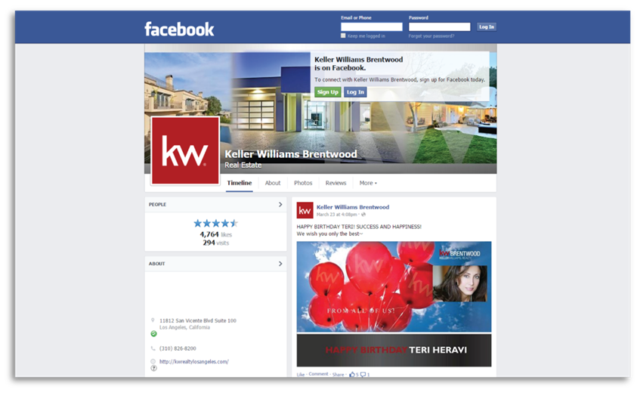
Reach the Influential
Find “Hidden Buyers”
Create Excitement
Invitations to Open Houses
Notes:
Replace the facebook image here with images of the Agent’s Facebook Profile.

Slide 16
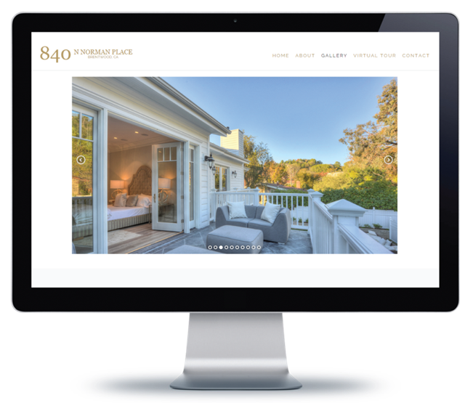
Reach the Influential
Find “Hidden Buyers”
Create Excitement
Invitations to Open Houses
Individual property websites are a very useful tool when marketing your home online. The unique domain name is simply the property address—when typed into a web browser, it instantly pulls up that specific property details page or virtual tour.
www.123NormanPlace.com
Notes:
Insert images of your website here and replace the address with the agent’s website.
You may right click the website image and hyperlink it to the website’s address so that when tapped on the tablet will navigate to the agent’s website.

Slide 17
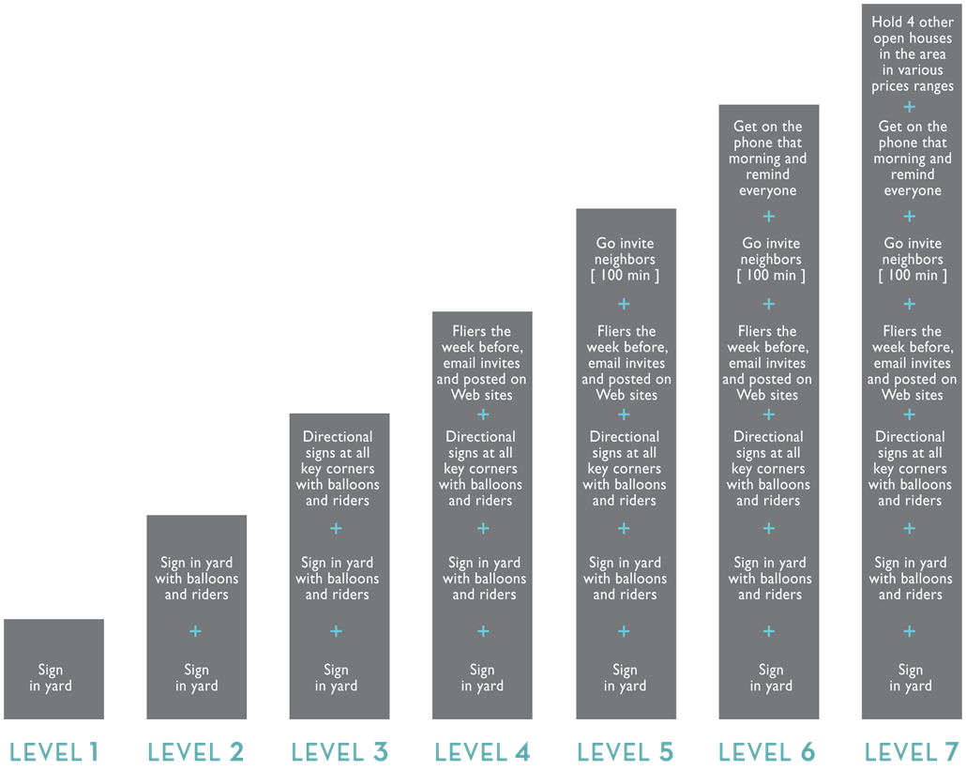
TAKING OPEN HOUSES BEYOND THE BASICS
Holding an open house is serious business. Below is a chart that shows you exactly how we can maximize open houses to sell your property.

Slide 19
Keller Williams is not your traditional Real Estate company. That is why it is not surprising that we are the #1 Real Estate Franchise in the World, by agent count.
Our phenomenal growth is only part of the story:
A network of over 180,000 real estate consultants
1000+ offices worldwide
Excellence in cutting-edge technology, real estate training, coaching and education

Slide 20
TECHNOLOGY
In August 2017, Keller Williams announced a $1 billion fund to fuel all the R&D and M&A required to build the real estate industry's preferred platform. With resources in place, KW remains focused on building technology that empowers agents to provide the best CONSUMER EXPERIENCE.
Keller Williams also is developing a new consumer app. This new home search experience will empower agents and consumers alike, uniting them inside one central point for communication, on-demand information and collaboration.
TEAMWORK
Keller Williams Realty was designed to reward agents for working together. Based on the belief that we are all more successful if we strive toward a common goal rather than our individual interests, I’m confident that every Keller Williams professional shares the common goal of serving you, my client, in the best way possible.
KNOWLEDGE
Keller Williams Realty helps me stay ahead of trends in the real estate industry through its comprehensive, industry-leading training curriculum and research resources. It’s what prepares me to provide you with unparalleled service.
RELIABILITY
Founded on the principles of trust and honesty, Keller Williams Realty emphasizes the importance of having the integrity to do the right thing, always putting your needs first. It reinforces my belief that my success is ultimately determined by the legacy I leave with each client I serve.
TRACK RECORD
I’m proud to work with the largest real estate franchise in the World by agent count. It’s proof that when you offer a superior level service, the word spreads fast.

Slide 21
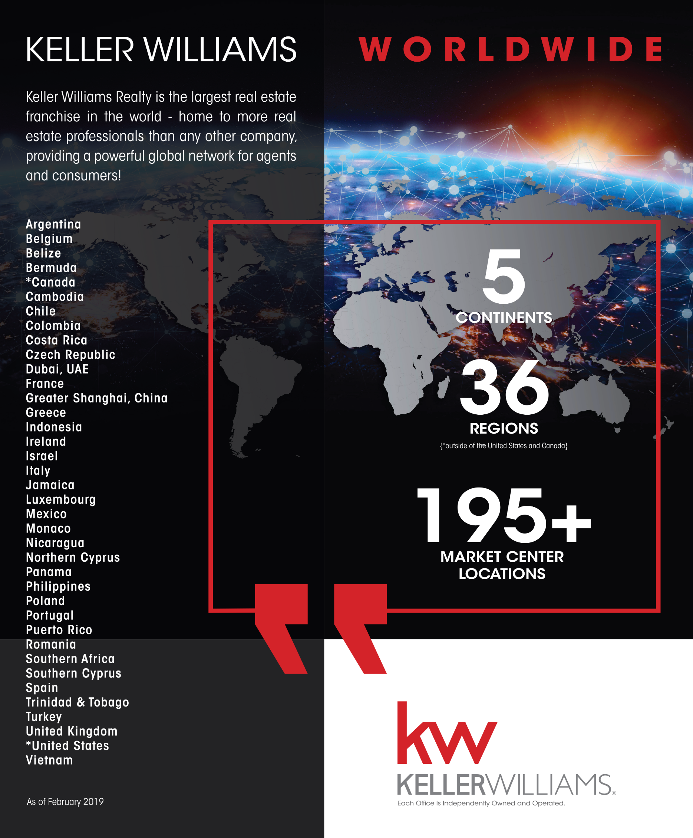

Slide 22
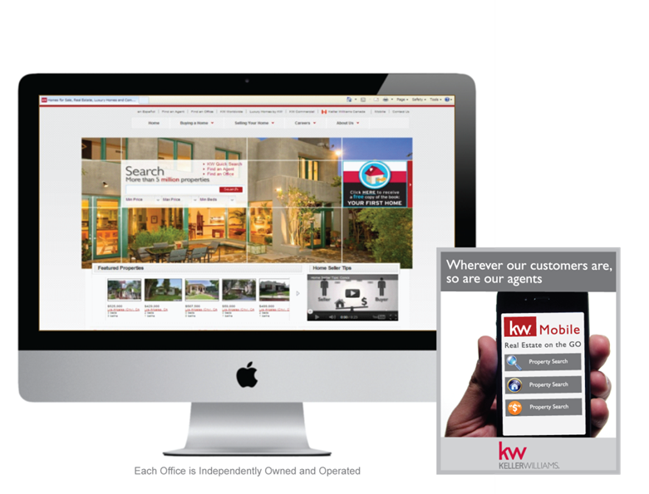
Our web network boasts 2.6 million unique visitors a month.
Among the features specifically designed to give consumers all the real estate information they want, are local featured listings on the landing page and a mobile optimized version of the site.
Keller Williams associates enjoy the benefits of receiving text messages directly from consumers through their listings
Listings have increased open house visibility via a real-time open house search

Slide 23
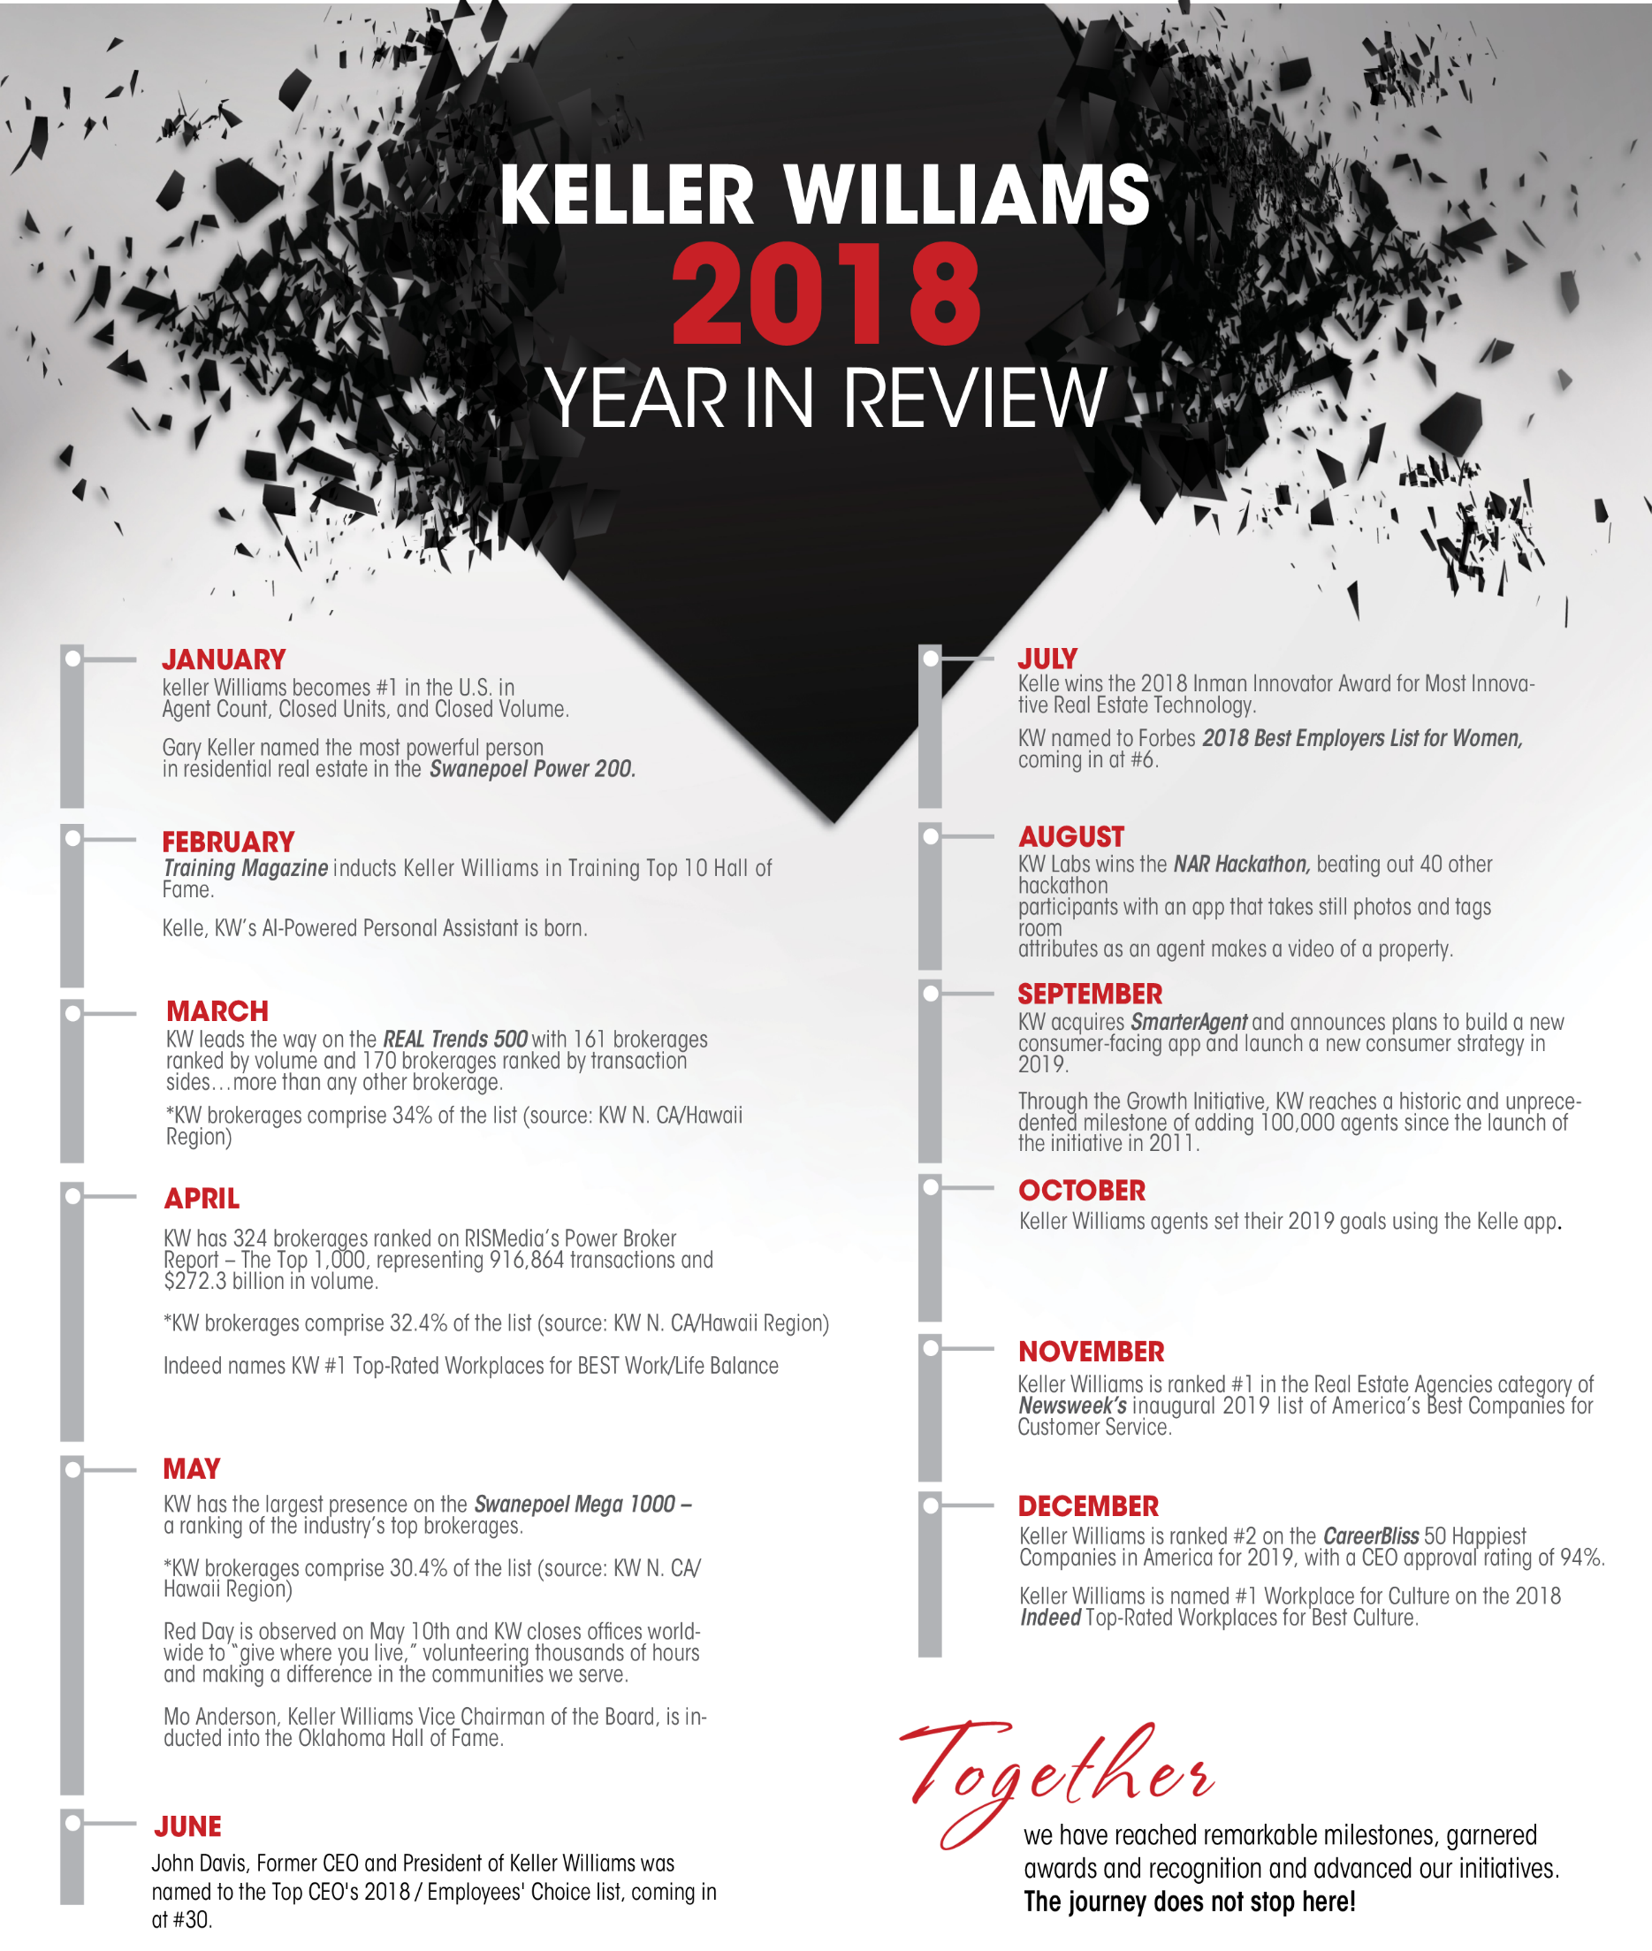

Slide 27
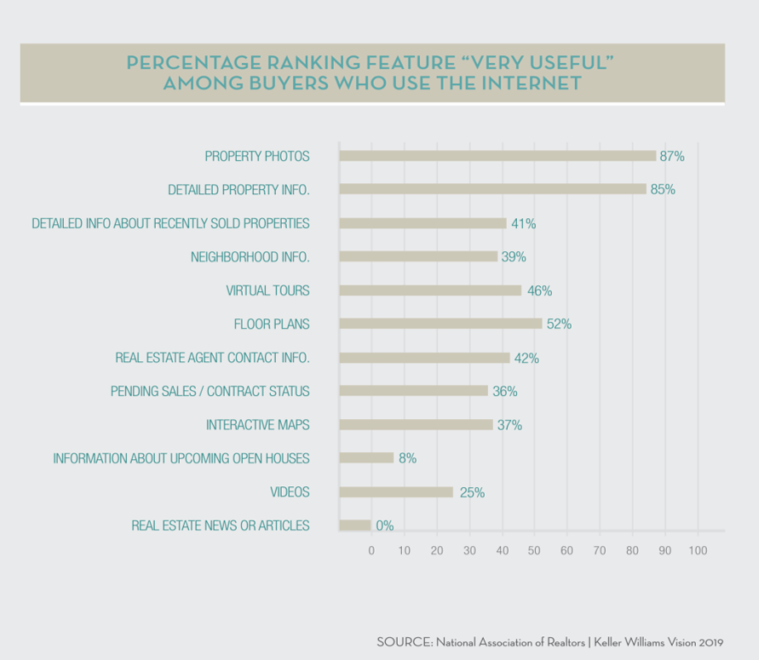

Slide 28
