Slide 1
MARKETING LISTING CONSULTATION
This presentation is property of Michael Lewis. 310-801-6040
Notes:
This is the iPad Listing presentation made exclusively for offices enrolled in the Michael Lewis Marketing Suite.
Software Required:
For editing: Powerpoint or Keynote
To play the powerpoint files (pptx) you’ll need Keynote installed on your iPad ($9.99 in the AppStore.)
You may also export this Listing Presentation as a .pdf and import it into your iBooks.
To share this document with your iPad you will need DropBox installed on your tablet.
Items Required to Customize this Presentation:
Headshot of Agent
Professional Bio / Profile of Agent
Letter to Agent’s Client
Link to Website
Link to Facebook
QR Code linking to your virtual tour (optional)
Client’s Name (optional)
This Listing presentation is extremely customizable. All pages may be edited, duplicated, and/or deleted to suite your personal needs.
You may replace any of the regional template photos with pictures of your area.

Slide 2
PREPARED EXCLUSIVELY FOR:
The clientele of
Agent Name
Notes:
This is where the client’s name goes.
Simply delete Michael Lewis’s information and replace it with the client’s information.
If you do not have a specific client at the moment then replace Michael’s information with this message:
“the clientele of {AGENT NAME}”
Change {AGENT NAME} with the agent.

Slide 3
PREPARED BY:
YOUR NAME
124 Anywhere, Any City, CA 123456
Office: 310.555.1234 | Fax: 310.555.1234
Email: abcd@kw.com | Website: www.agentwebsite.com
Notes:
Right click the Agent Photo and select “Change Picture.”
Navigate to your headshot and open it. Your headshot should automatically crop.
Change the contact information at the bottom of this document with your office and business contact information.

Slide 4
John Doe
1234 Anywhere Place
Anywhere, Any State
123456
Dear Jane Doe,
This is where you type your personal letter to your potential client. This is where you type your personal letter to your potential client. This is where you type your personal letter to your potential client. This is where you type your personal letter to your potential client. This is
This is where you type your personal letter to your potential client. This is where you type your personal letter to your potential client. This is where you type your personal letter to your potential client. This is where you type your personal letter to your potential client. This is where you type your personal letter to your potential client.
where you type your personal letter to your potential client. This is where you type your personal letter to your potential client. This is
This is where you type your personal letter to your potential client. This is where you type your personal letter to your potential client. This is where you type your personal letter to your potential client. This is where you type your personal letter to your potential client. This is where you type your personal letter to your potential client.
Sincerely,
John Doe
Notes:
Replace this text with your prepared letter to your client.
Keep a general letter here but switch out the client name when applicable.

Slide 5
PROFESSIONAL PROFILE
Your Name
Managing Partner
Keller Williams Realty
This is where you put your professional profile. You can say all of
Your accomplishments. This is where you put your professional profile. You can say all of Your accomplishments. This is where you put your professional profile. You can say all of your accomplishments.
Listing Things here
Listing Things here
This is where you put your professional profile. You can say all of
Your accomplishments. This is where you put your professional profile. You can say all of Your accomplishments. This is where you put your professional profile. You can say all of your accomplishments.
This is where you put your professional profile. You can say all of
Your accomplishments. This is where you put your professional profile. You can say all of Your accomplishments. This is where you put your professional profile. You can say all of your accomplishments.
YOUR NAME HERE
Notes:
Replace this photo with the agent headshot and replace YOUR NAME HERE with the agent’s name.
Replace the Professional Profile template text with your prepared professional bio/profile.

Slide 6
MARKETING STRATEGY:
MARKETING STRATEGY
Notes:
This is the marketing section. This is where the agent can talk about their marketing services as well as get a feel for how the client would like to market their property.

Slide 7
INTERNET MARKETING
Extended Market Reach
When you list with me, we’ll have access to the Keller Williams Listing System, or KWLS. This proprietary, exclusive system ensures your property is marketed online 24/7 through more than 350 of the most popular search Websites.

Slide 8
PRINT MEDIA
Keller Williams agents strategically advertise in several publications. Our display advertising appears in local, regional and national / international publications, which target specific audiences for unique or estate properties. Your sales agent will select the publications appropriate for the marketing of your property.
Notes:
This print media section can be customized to reflect the print media your office uses. If your office does not use print media feel free to delete these slides.

Slide 9
PROFESSIONAL PHOTOGRAPHY

Slide 10
PROPERTY FLYERS

Slide 11
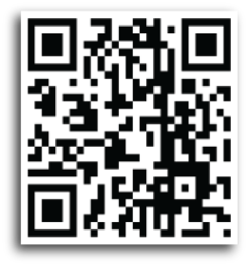
Technology Driven Marketing
QUICK RESPONSE CODES
Put on All Marketing Materials
Designed to Direct User to another Destination.
DIGITAL VIDEO MARKETING
Your Property Virtual Tour will be loaded on YouTube for Online Marketing Exposure
Notes:
Replace the default QR Code with a QR Code generated for the agent’s listing when available. If they do not yet have a virtual tour then the agent may use the default QR Code. It’s functional and when scanned links to a template virtual tour we have created.

Slide 12
POSTCARD MAILINGS

Slide 13
WEBSITE EXPOSURE
www.yourwebsite.com
Notes:
Insert images of your website here and replace the address with the agent’s website.
You may right click the website image and hyperlink it to the website’s address so that when tapped on the tablet will navigate to the agent’s website.

Slide 14
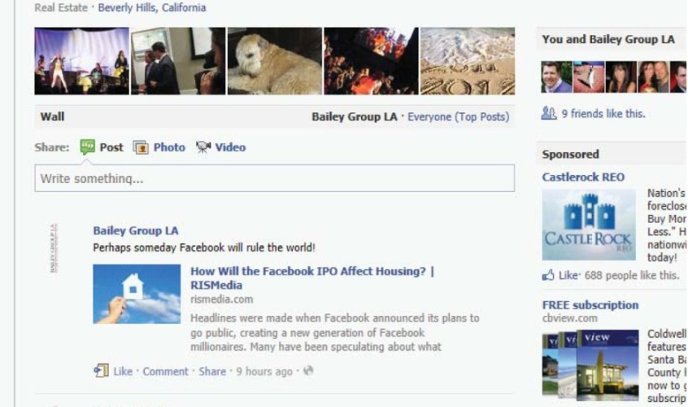
SOCIAL MEDIA
”
Notes:
Replace the facebook image here with images of the Agent’s Facebook Profile.

Slide 15
STAGING
We want your home to be shown in the best possible light to prospective buyers to get you top dollar in the shortest amount of time.
We will create a warm and inviting environment focusing on the best architectural features and selling points of your home.

Slide 16
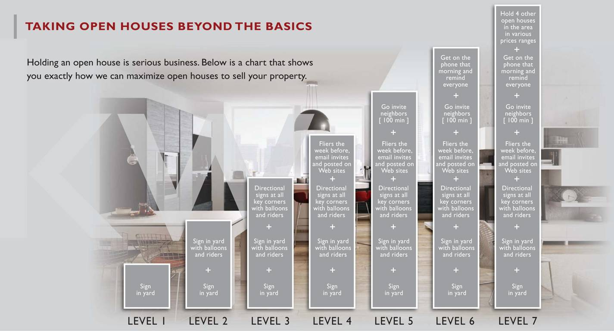
EXTENDED MARKET REACH

Slide 17
WHY KELLER WILLIAMS

Slide 18
WHY KELLER WILLIAMS
Keller Williams is not your traditional Real Estate company. That is why it is not surprising that we are the #1 Real Estate Franchise in the World, by agent count. Our phenomenal growth is only part of the story:
A network of over 180,000 real estate consultants.
1000+ offices worldwide
Excellence in cutting-edge technology, real estate training, coaching and education

Slide 19
WHY KELLER WILLIAMS
Technology
In August 2017, Keller Williams announced a $1 billion fund to fuel all the R&D and M&A required to build the real estate industry's preferred platform. With resources in place, KW remains focused on building technology that empowers agents to provide the best CONSUMER EXPERIENCE.
Keller Williams also is developing a new consumer app. This new home search experience will empower agents and consumers alike, uniting them inside one central point for communication, on-demand information and collaboration.
Teamwork
Keller Williams Realty was designed to reward agents for working together. Based on the belief that we are all more successful if we strive toward a common goal rather than our individual interests, I’m confident that every Keller Williams professional shares the common goal of serving you, my client, in the best way possible.
Knowledge
Keller Williams Realty helps me stay ahead of trends in the real estate industry through its comprehensive, industry-leading training curriculum and research resources. It’s what prepares me to provide you with unparalleled service.
Reliability
Founded on the principles of trust and honesty, Keller Williams Realty emphasizes the importance of having the integrity to do the right thing, always putting your needs first. It reinforces my belief that my success is ultimately determined by the legacy I leave with each client I serve.
Track Record
I’m proud to work for the #1 Real Estate Franchise in the World, by agent count! It’s proof that when you offer a superior level of service, the word spreads fast.

Slide 20
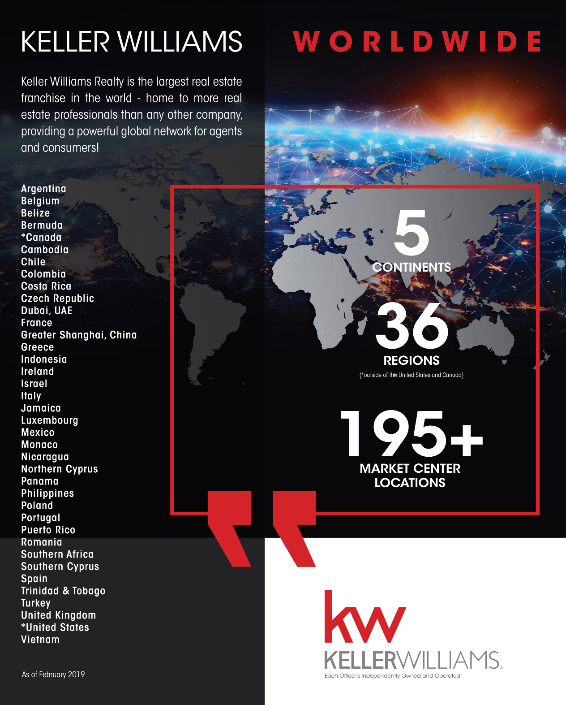

Slide 21
CONSUMER-CENTRIC KW.COM

Slide 23
KELLER WILLIAMS AWARDS & HONORS

Slide 24
MARKET STATISTICS

Slide 25
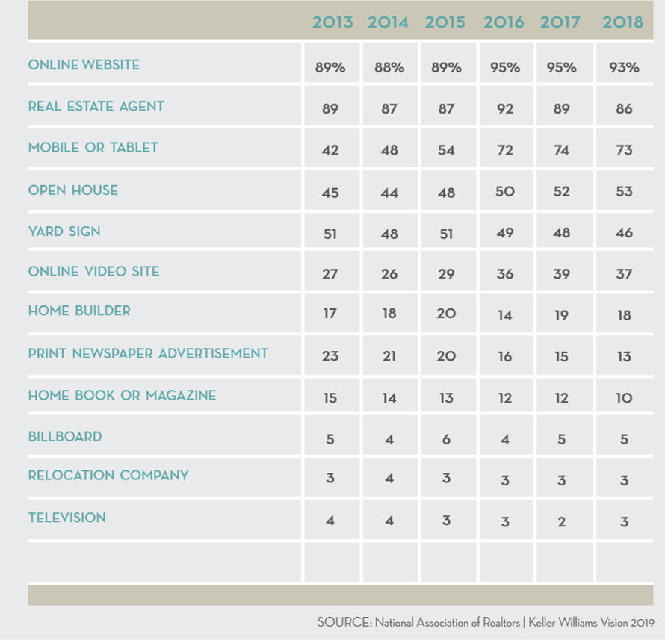
SOURCES USED IN HOME SEARCH
2013
2014

Slide 26
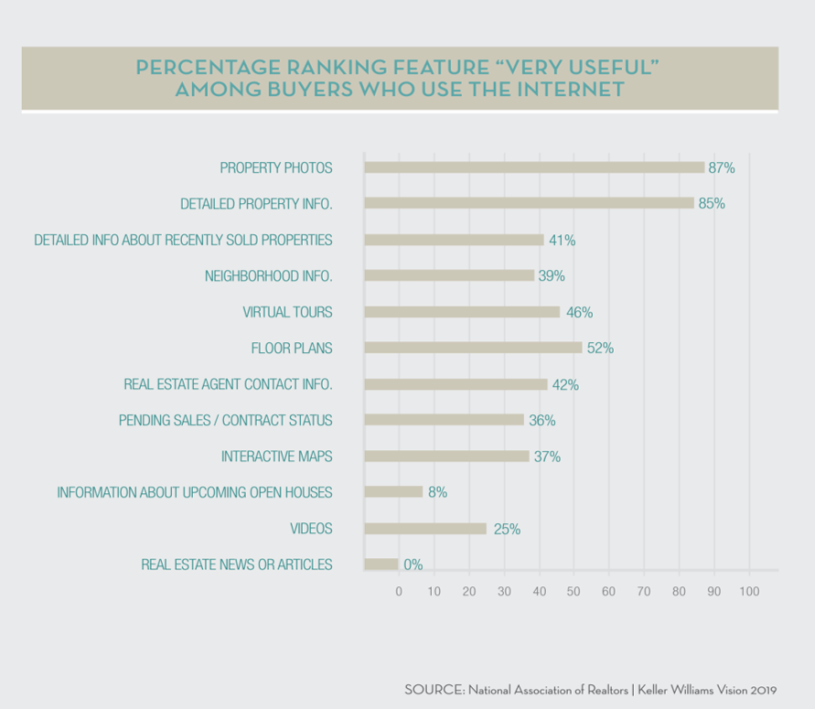
VALUE OF WEBSITES

Slide 27
WHAT BUYERS WANT MOST FROM AGENTS

Slide 28
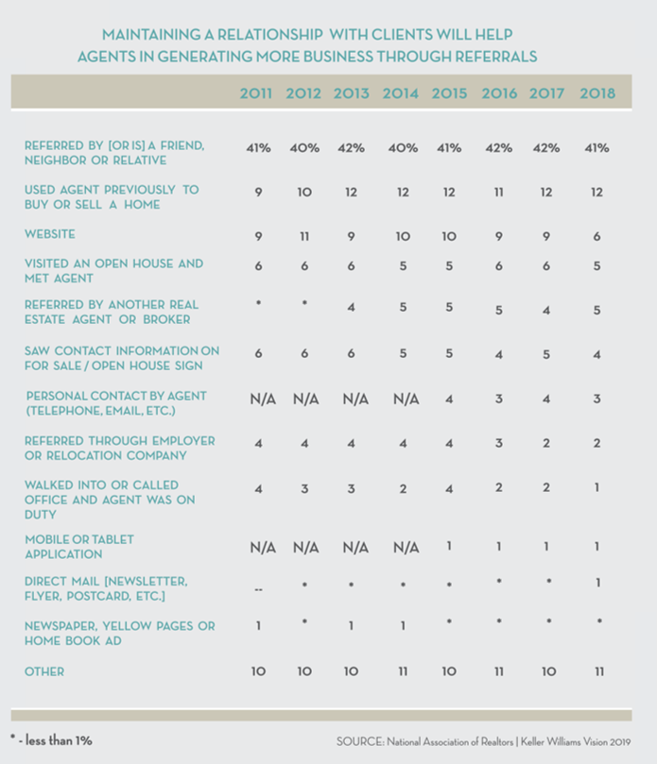
HOW BUYERS FOUND THEIR AGENT
2012
2013
2014

Slide 29
PRICING

Slide 30
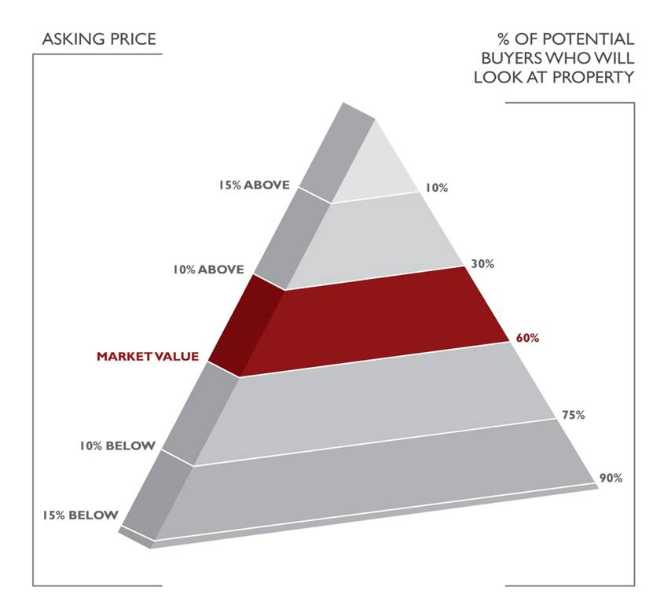
PRICE RIGHT –ATTRACT BUYERS
Pricing your property competitively will generate the most activity from agents and buyers.
Pricing your property too high may make it necessary to drop the price below market value to compete with new, well priced listings.

Slide 31
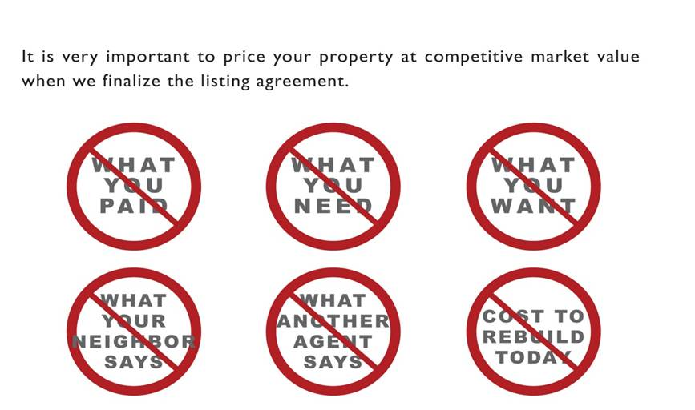
PRICING MISCONCEPTIONS
The value of your property is determined by what a buyer is willing to pay and a seller is willing to accept in today’s market.
Buyers make their pricing decision based on comparing your property to other properties SOLD in your area. Historically, your first offer is usually your best.

Slide 32
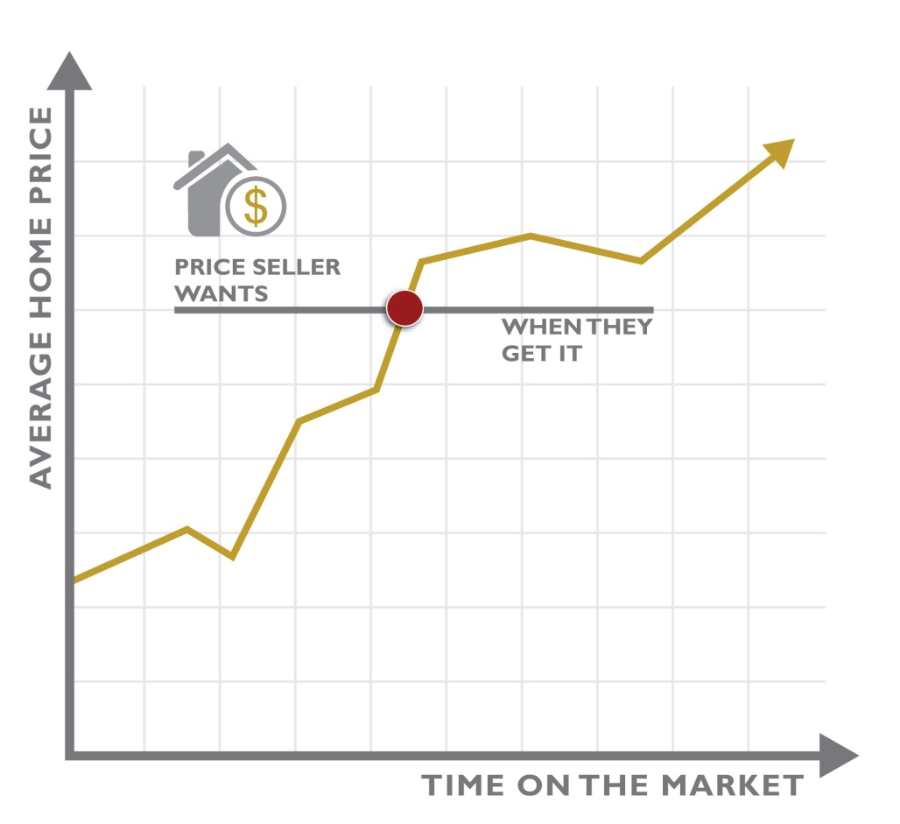
PRICED AHEAD OF THE MARKET

Slide 33
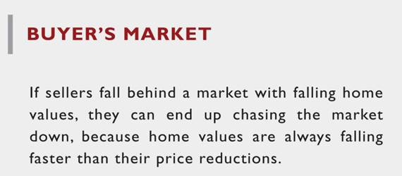
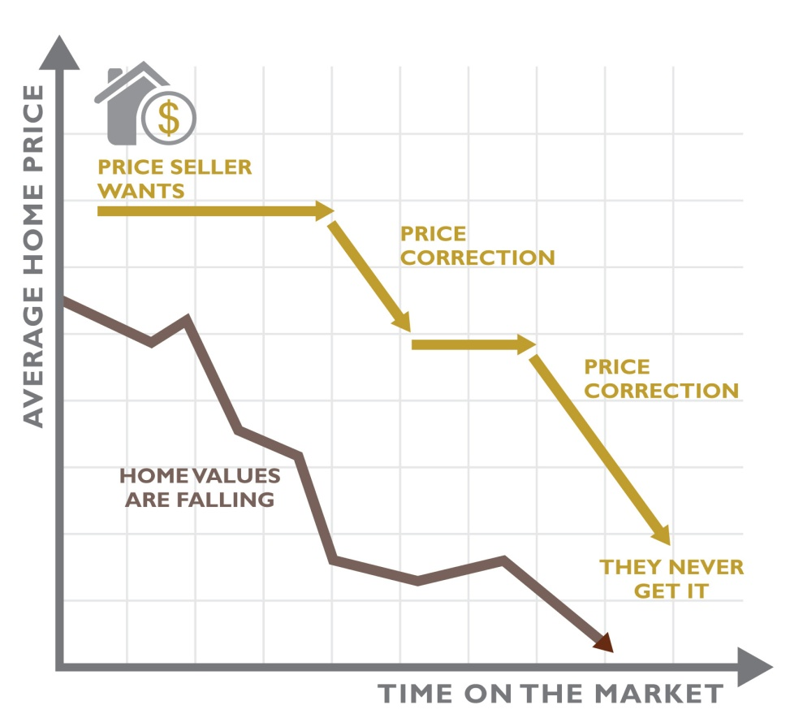
PRICED AHEAD OF THE MARKET

Slide 34
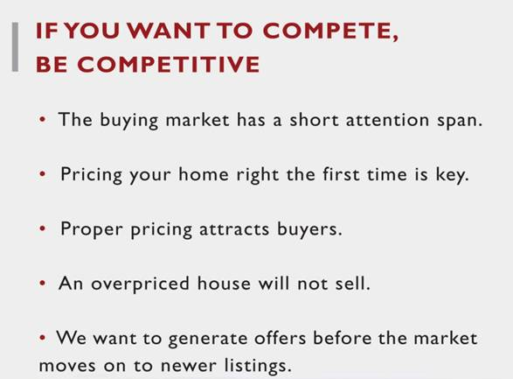
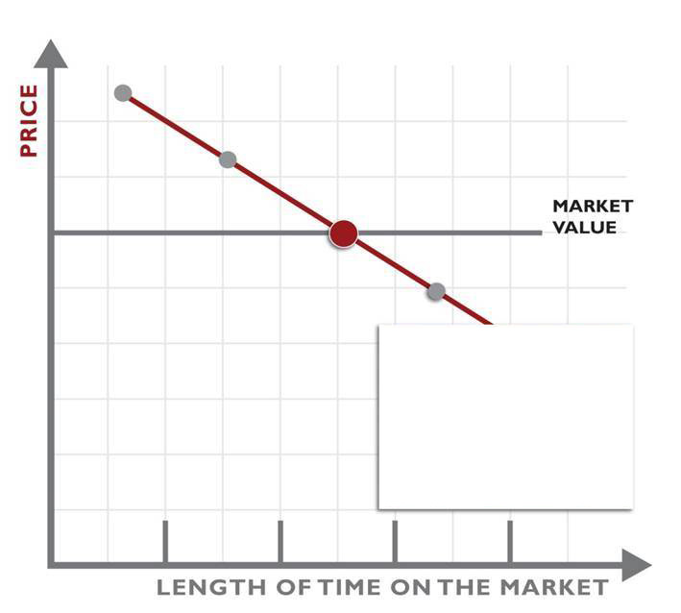
PRICE RIGHT – TIME ON THE MARKET WORKS AGAINST YOU

Slide 35
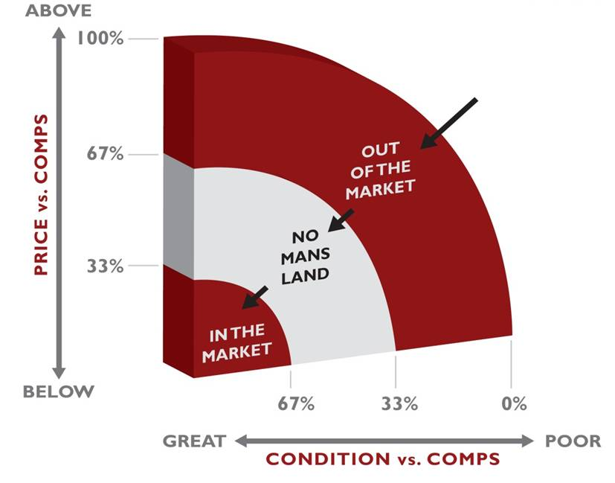
WHAT SELLS – RIGHT PRICE
To get your home sold for the most money in the least amount of time, we have to price it “in the market”.

Slide 36
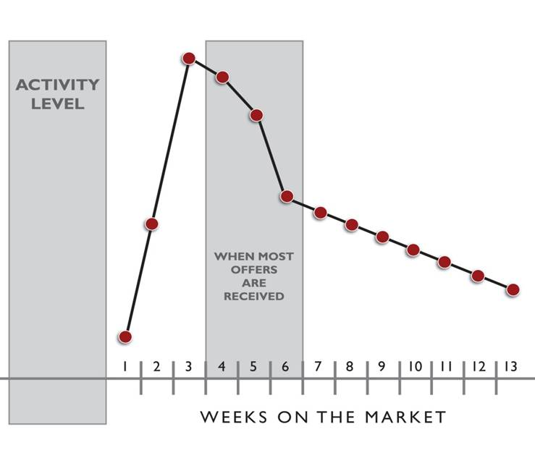
PRICE COMPETITIVELY – THE FIRST 30 DAYS ARE CRITICAL

Slide 37
Notes:
This is a blank template slide that you may use to customize how you like. Use it to get creative with your Listing Presentation!

